Slide 1

E-College Portal
Guided By:
Bakul Joshi
SUSHANT VISHWAS DESHPANDE 250243020023
ONKAR SHIVAJI LAVANGE 250243020049
RAJKUMAR PRAJAPATI 250243020073
NUPUR VISHNU SIDDAM 250243020094

Slide 2
E-College Portal – Your Digital Campus Companion Purpose: A one-stop online platform to manage academic & administrative tasks effortlessly. Key Highlights: Centralized Access – Students, staff, and admins on a single platform. Efficient & Paperless – Automates routine processes and reduces manual work. Anytime, Anywhere – 24/7 accessible for convenience and transparency.

Slide 3
Why E-College Portal
One-stop platform for academic & administrative services
Improves communication & transparency
Accessible anytime, anywhere
User-friendly, paperless
Centralizes study materials, announcements & events Saves time through automation

Slide 4

3
Project Overview
The E-College Portal is an integrated web application designed to digitize and streamline key academic and administrative functions in a college environment.
Portal provides seamless access to academic resources, course management, events, internships, placements and feedback mechanisms for students, staff, and administrators.
Staff can manage course content, events and announcements.
Admin manages users, courses and feedback.
Enhances communication, coordination, and operational efficiency in the academic environment.

Slide 5

Student
Primary beneficiaries of the portal. They are enrolled learners who use the system to manage their academic journey.
Staff
Faculty members and support staff responsible for delivering courses and managing academic activities.
Admin
Management-level users who oversee the entire portal and ensure smooth functioning.
Users

Slide 6
Use Cases

Slide 7
Student
Create account and Login
Update Profile Information
View Personalized Dashboard
Browse and Register for Skill Development Courses
Access Enrolled Courses and Course Materials
Register for Events
Apply for Internships and Placements
Track Application Status
Provide Feedback for Courses, Faculty , Events.

Slide 8
Staff
Login
Update Profile Information
View Personalized Dashboard
Manage Course Materials
Manage Events
Manage Placement activities
Post Announcements
Admin
Login
Manage User Accounts
Manage Course Catalog
Review Student’s Feedback

Slide 9
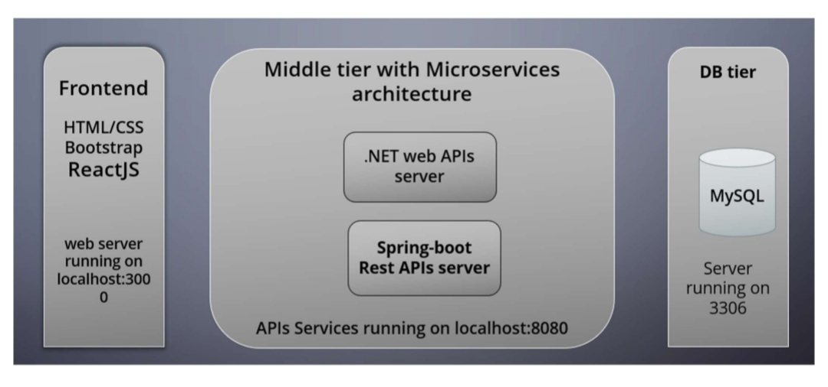
Project Architecture

Slide 10
Project Methodology
1.Requirement Analysis
BRS (Business Requirement Spec)
SRS (Software Requirement Spec)
Use Case diagrams (Student, Staff, Admin)
2.ER Diagram & DB Schema Design
Define tables like Student,Staff,Course,Event,Announcement etc.
Normalize and define relationships (FKs for mapping)
3.Microservice Planning & Repository Setup
Finalize services:
Login/Register Microservice(Spring Boot)
Student Microservice (Spring Boot)
Staff Microservice (Spring Boot)
Admin Microservice (.NET)
Set up separate GitHub repos or module folders

Slide 11
Future Scope
1.Mobile App Development
Native Android apps with offline access
2.Chatbot Integration
AI based assistant for instant response to queries.
3. Alumni Networking Portal
Connect alumni with students for mentorship and opportunities.

Slide 12
Conclusion
The E-College Portal streamlines academic and administrative processes through a centralized, user-friendly platform for students, staff, and administrators. With features like profile management, course registration, events, internships, and feedback, it enhances communication, accessibility, and efficiency, while its modular design ensures scalability for future enhancements.

Slide 13
THANK YOU!

